Slide 1
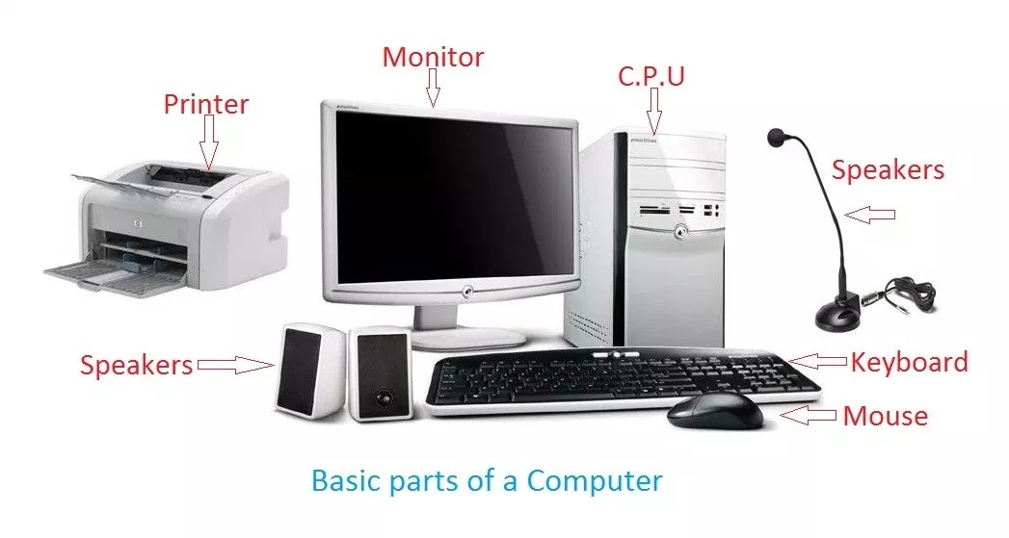
What is a Computer?
A computer is an electronic device that accepts data as input and processes it with a set of instructions (a program) to produce the result as output.

Slide 2
Working of a Computer
There are three stages in the working of a computer:
INPUT: The data and the instructions, which we enter using a keyboard or a mouse into a computer, are called Input.
Instruction : (c=a+b) data: a=10,b=20
PROCESSING: After entering data and instructions in a computer, the CPU works on the input to give us meaningful information. This is called Processing.
OUTPUT: The meaningful information that we get after processing is called Output.
This Input- Process- Output Cycle is also called IPO Cycle.

Slide 3
Information Processing System

Slide 4
Characteristics of Computer
1.Speed
2.Accuracy
3.Diligence
4.Versatality
5.Storage
6.No Feeling

Slide 5
1.Speed
Computers are much faster to perform mathematical calculations than human. (calculate the average monthly income of 1000 persons.)
The computer is capable of performing millions of tasks per second.
It takes an hour or a day for a person to do a mathematical calculation or any work, to do the same calculation or work to a computer do in nanoseconds or picoseconds.

Slide 6
2.Accuracy
If the data is entered into the computer, the result obtained will be absolutely accurate.

Slide 7
3.Diligence
A person gets tired of doing some work in a few hours and a computer has the ability to do any work continuously for many hours, days, months (He may lose his concentration, speed, and accuracy because man suffers from fatigue,excessive strain,etc).
Even after the computer has worked for such a long time, there is no decrease in its ability to work and the accuracy of the result.
Unlike human beings, a computer is free from monotony, tiredness, lack of concentration etc

Slide 8
4.Versatality
A computer can do multiple tasks at the same time.
users can play songs, work on documents, search for any documents in hard disk, surf the internet, use software, calculate, etc.
It means the capacity to perform a completely different type of work.
One moment, it is preparing the results of particular examination, the next moment it is busy preparing electricity bills.
When a computer is engaged in preparing financial statements, it may be used for writing a letter or may be used for playing game simultaneously.

Slide 9
5.Storage
The computer has a mass storage section where we can store a large volume of data for future use.
Such data are easily accessible when needed.
Magnetic disk, magnetic tape, and optical disk are used as mass storage devices.
The storage capacity of the computer is measured in terms of Kilobyte (KB), Megabyte (MB), Gigabyte (GB), and Terabyte (TB).
Computers have the ability to store all types of data such as data, pictures, files, programs, games, and sound for many years and later we can get any data in a few seconds at any time for taking that information and for future retrieval.

Slide 10
6.No Feeling
A computer is a machine which works continuously on the instruction of humans without any selfishness and without tiredness.
It does not have feelings or emotions, taste, knowledge, and experience.
Thus it does not get tired even after long hours of work.

Slide 11
Applications of Computer
Here are the list of uses or applications of computer:
Education
Business
Banks
Communication
Engineering
Book Publishing

Slide 12
Education
To teach students creatively with data visualization.
Drawing tools, spreadsheets, and PowerPoint presentations, etc. are very beneficial for students to learn more deeply and accurately.
Universities are now providing online courses for college students.

Slide 13
Buisness
Computer with an internet connection is really important for businesses. Now they can do Internet marketing, they can sell products and services online.
Excel spreadsheets to manage goods and services, Powerpoint for project presentations are common these days.
Any individual today can start their business from home. Freelancing is a big example. Freelancers are working remotely from home with the use of computers and the internet.

Slide 14
Hospitals
Hospitals can create a database of a patient with their treatment records.
The use of computer and its application in hospitals are such as to do the research on diseases, blood test, and brain testing, and body scanning, etc.
For example in ICU (Intensive Care Unit) chamber in hospital, computer keeps track of each and everything going inside the patient's body such as blood pressure and Heartbeat etc.

Slide 15
Book Publishing
Book publishing becomes an easy task with the use of computer.
Book publishers are now using DTP (Desktop publishing) software like MS-Word to publish their books.

Slide 16
Engineering
Design any machine without actually making it through CAD (Computer aided design) softwares and once the design is accepted, and then using CAM (Computer aided manufacturing) process company can produce a large number of such products at very fast speed.
Architects are also using computers to draw and design individual houses to big buildings like Apartments.

Slide 17
Banks
Banks are the place where there is continuous uses of computer or we can says that banks are the major users of computers.
For example, ATM (Automated teller machine) is used where we are free to either deposit or withdraw our cash in/from our Bank.
In banks, all information such as account holders detail, deposits, withdrawal, interest, etc. are managed by computers.
Banks are also using computer network to interconnect all of its branches so that their users feel always free to deposit his or her money in any branch of the same bank.

Slide 18
Communication
Using email, you can also saves your time and cost to deliver any information very fast. You only need a computer and internet connectivity.
Peoples are using chat message, email, voice-mail etc. for communication purpose.
Use computer to communicate through direct video conference with your contacts/friends present at any place without any cost except internet connectivity.

Slide 19
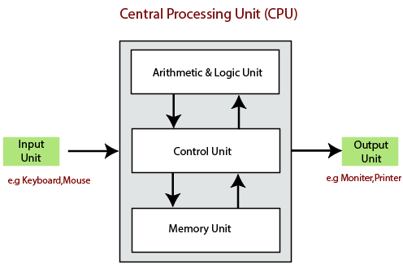
Block Daigram of Computer

Slide 20
Input Devices
We can enter the data from the outside world into the primary storage as the input through input devices.
The input devices are the medium of communication between the outside world and the computer system.
These devices take input and convert it into binary language that the computer understands.
The input devices receive or accept the data or instruction from the user, who exist in the outside world.
These devices convert the data or instruction into the machine-readable form for further processing.
The input device performs like the connection between the outside world and our computer system.
The keyboard and mouse are common examples of input devices.
When the whole procedure is finished, we get the desired output from the output devices such as monitor, printer, etc.

Slide 21
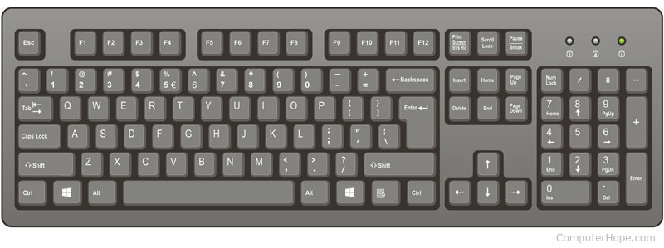
Keyboard
A computer keyboard is one of the primary input devices used with a computer.
A keyboard is composed of buttons that create letters, numbers, and symbols, and other functions.

Slide 22
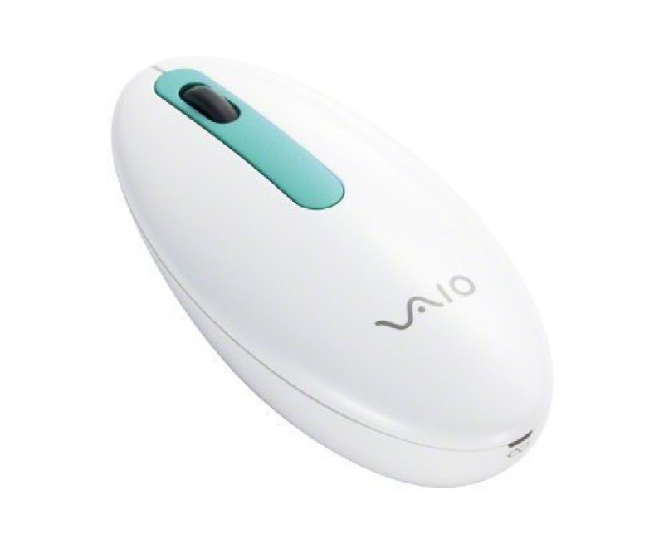
Mouse
A computer mouse is a handheld hardware input device that controls a cursor in a GUI (graphical user interface) and can move and select text, icons, files, and folders on your computer.

Slide 23

Touch Pad
A touch pad is a device for pointing on a computer display screen.
It is an alternative to the mouse.
Originally incorporated in laptop computers.
A touch pad works by sensing the user's finger movement and downward pressure.

Slide 24
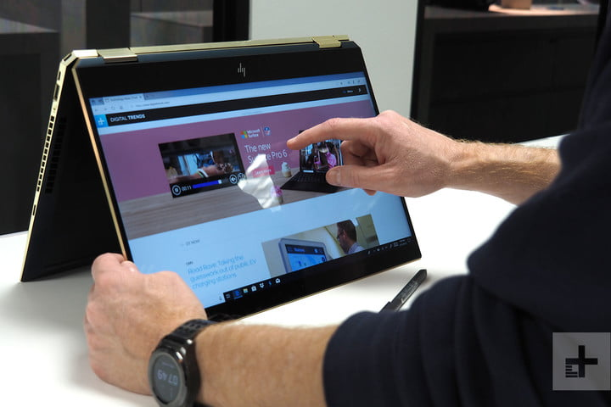
Touchscreen
A touchscreen is a computer screen that can be used by touching it with a finger or a stylus pen, instead of using a mouse and keyboard.

Slide 25
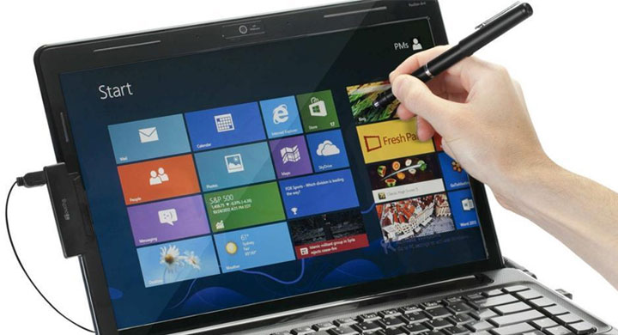
stylus
A stylus (or stylus pen) is a small pen-shaped instrument whose tip position on a computer monitor can be detected.
It is used to draw, or make selections by tapping.

Slide 26
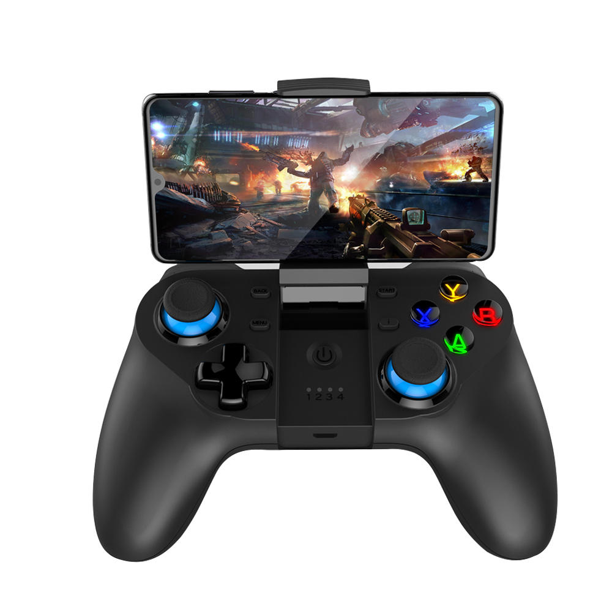
Joystick
A joystick is an input device that can be used for controlling the movement of the cursor or a pointer in a computer device.

Slide 27

webcam
A webcam – short for ‘web camera’ – is a digital camera that’s connected to a computer.
It can send live pictures from wherever it’s sited to another location by means of the internet.

Slide 28
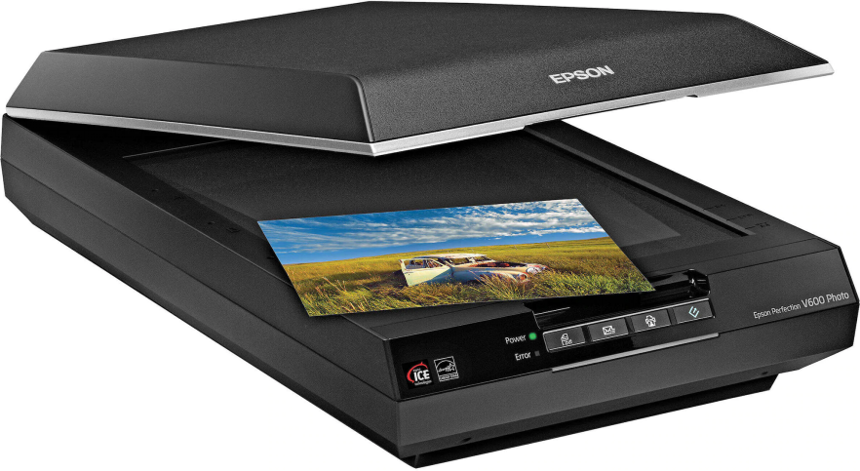
scanner
A scanner is an input device that scans documents such as photographs and pages of text.
When a document is scanned, it is converted into a digital format.
This creates an electronic version of the document that can be viewed and edited on a computer.

Slide 29
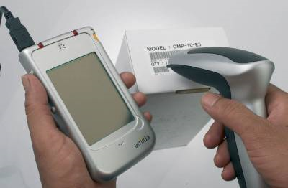
Bar code readers

Slide 30
Output Devices
An output device is any piece of computer hardware equipment which converts information into human-readable form. It can be text, graphics, tactile, audio, and video.
Some of the output devices are Monitor, Printer, Plotters, Speakers etc.

Slide 31

Monitor
A computer monitor is an output device that displays information in pictorial form.

Slide 32
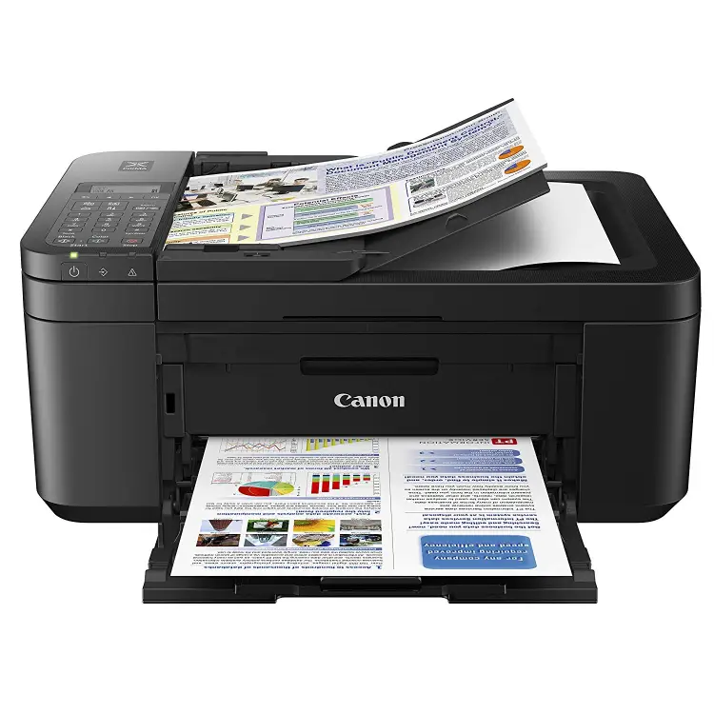
printer
a printer is a peripheral device which makes a representation of graphics or text, usually on paper.

Slide 35
Memory
A memory is just like a human brain.
It is used to store data (a=10,b=20) and instructions (c=a+b).
Computer memory is the storage space in the computer, where data is to be processed and instructions required for processing are stored.
The memory is divided into large number of small parts called cells.
Each location or cell has a unique address

Slide 37
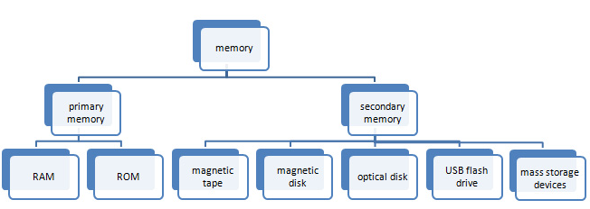
Memory

Slide 38
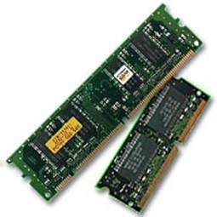
Primary Memory
Primary Memory (Main Memory)
Primary memory holds only those data and instructions on which the computer is currently working.
It has a limited capacity and data is lost when power is switched off.

Slide 40
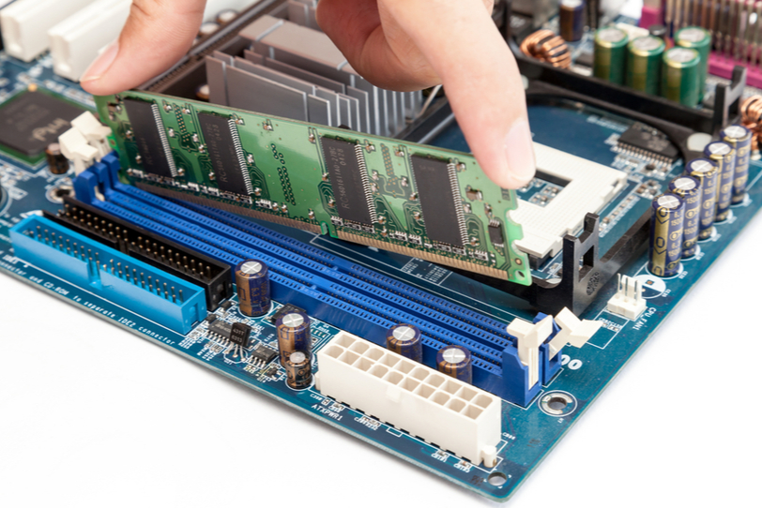

Slide 41
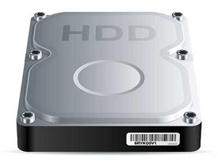
Secondary Memory
This type of memory is also known as external memory or non-volatile.
It is slower than the main memory.
These are used for storing data/information permanently.
The contents of secondary memories are first transferred to the main memory, and then the CPU can access it.
examples: disk, CD-ROM, DVD, etc.

Slide 43
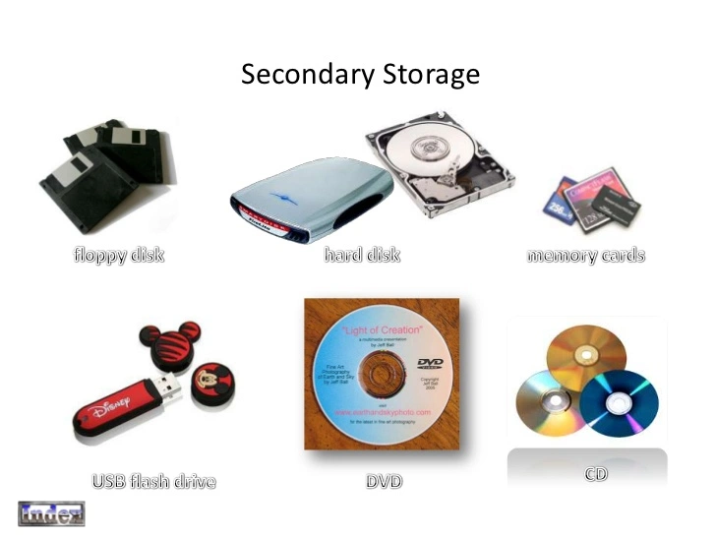

Slide 45
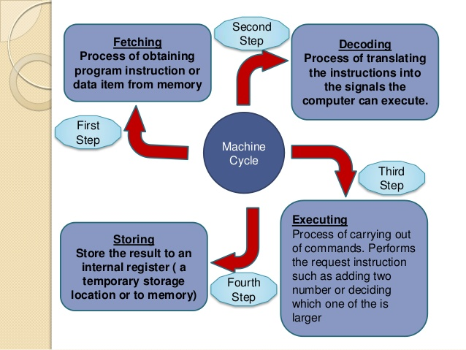

Slide 46
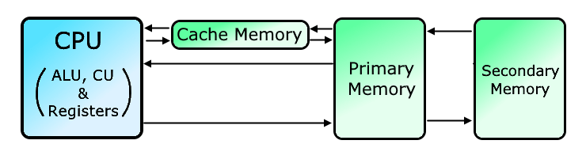
Cache Memory
Cache memory is costlier than main memory or disk memory but economical than CPU registers.
Cache memory is an extremely fast memory type that acts as a buffer between RAM and the CPU.
It holds frequently requested data and instructions so that they are immediately available to the CPU when needed.
Cache memory is used to reduce the average time to access data from the Main memory.
Cache memory is used for storing the data which is given by the user as input and is necessary for the computer microprocessor to perform a task that is it keeps frequently requested data and instructions so that they are immediately available to the CPU when needed.

Slide 47
Why cache is needed?
The cache memory is required to balance the speed mismatch between the main memory and the CPU. The processor is very fast, while the main memory access time is comparatively slower. Hence, the processing speed depends more on the speed of the main memory.
advantages of cache memory
The main memory is slower than cache memory.
It creates a way for fast data transfers so it consumes less access time as compared to main memory.
It stores frequently access that can be executed within a short period of time.
Disadvantages of cache memory
It is limited capacity memory.
It is very expensive as compared to Memory (random access memory (RAM)) and Hard Disk.

Slide 48
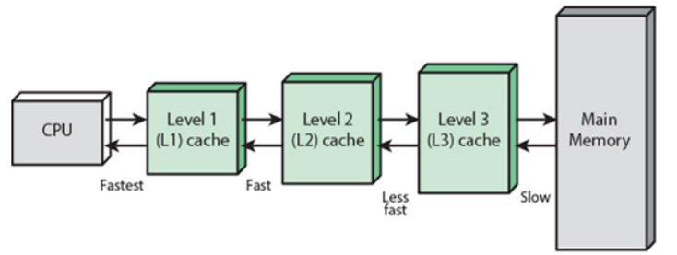

Slide 49
L1 cache
It is a type of memory in which data is stored and accepted that are immediately stored in the CPU. Generally, the L1 cache is the smallest in size and built into the processor chip.
L2 cache
L2 caches for larger processors but take longer to access. It is generally part of the CPU, L2 cache has more capacity than L1.
The processor searches Instructions in the L1 cache, if required data or instructions not found then it searched into L2 cache.
L3 cache
The L3 cache is slower than L1 and L2 but larger. If data can’t be found in the L2 cache, the CPU it searched into L3 cache. if required data or instructions not found in L3 cache then cpu searched into main memory.

Slide 50
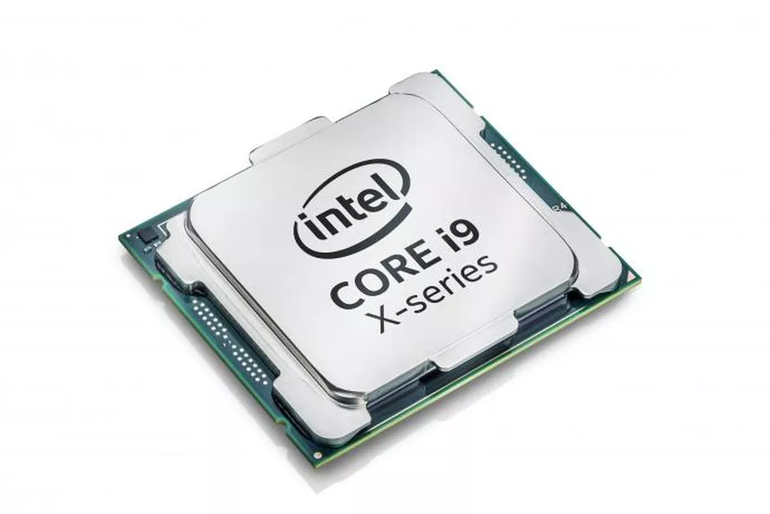
Central Processing Unit (CPU)
Once the information is entered into the computer by the input device, the processor processes it.
The CPU is called the brain of the computer.
The CPU has three main components :
1)Arithmetic Logic Unit (ALU), 2)Control Unit (CU)
3)Memory registers

Slide 51
Arithmetic and Logic Unit (ALU)
Performs mathematical calculations.
The ALU uses operands and code that tells it which operations to perform for input data.
Arithmetic calculations include addition, subtraction, multiplication and division.
Logical decisions involve comparison of two data items to see which one is larger or smaller or equal.

Slide 52
Control Unit
A control unit works by receiving input information that it converts into control signals, which are then sent to the central processor.
The computer's processor then tells the attached hardware what operations to carry out.
The Control unit coordinates and controls the data flow in and out of CPU and also controls all the operations of ALU, memory registers.

Slide 53
Fetch
In the fetch cycle, the control unit looks at the program counter register (PC) to get the memory address of the next instruction. It then requests this instruction from main memory and places it in the instruction register (IR).
Decode
Here, the control unit checks the instruction that is now stored within the instruction register (IR). It looks at the instruction - which is just a sequence of 0s and 1s and decides what needs to be done. Does the instruction say to add two numbers? Does it say to load a value from memory? The control unit interprets the binary instruction to answer questions like these.
Execute
Now the control unit sends the signals that tell the ALU, memory, and other components signals to cause them to perform the correct work.

Slide 54
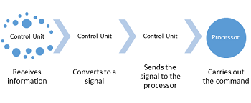

Slide 55
Memory Registers
registers are temporary storage unit to store or hold and transfer data or instruction.
CPU fetch the data or instruction from the main memory. Following by this, CPU hold them in the registers, the temporary memory areas.
CPU decode the data or instruction that it has just fetched. The main purpose of this step is to make sure that CPU has understand the set of instructions which is to be executed.
Registers are closely connected to the Arithmetic and Logic Unit (ALU) inside the CPU so that data or instruction can be accessed faster.
Registers may not only store data, but also the address in memory where the data is stored.
Each register inside the CPU has a specific function like storing data, storing an instruction, storing address of a location in memory etc.

Slide 56
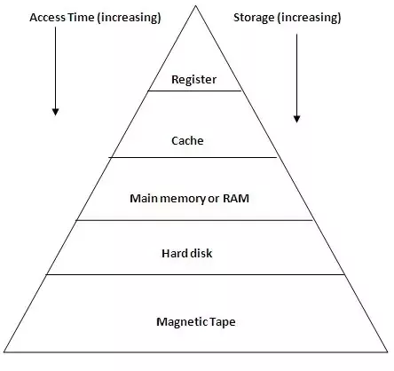

Slide 58
Read Only Memory(ROM)
ROM, which stands for read only memory, is a memory device that stores information permanently.
It is called read only memory as we can only read the programs and data stored on it but cannot write on it.
The manufacturer of ROM fills the programs into the ROM at the time of manufacturing the ROM. After this, the content of the ROM can't be altered, which means you can't reprogram, rewrite, or erase its content later.
However, there are some types of ROM where you can modify the data.
It is a non-volatile memory as it holds the information even when the power is turned off, or you shut down your computer.
The data which is stored permanently on smartphones, tablets, TV, AC, etc. is also an example of ROM.

Slide 59
ROM
Startup instructions stored in ROM which are required to start the computer during the booting process.
The work of the booting process is to start the computer. It loads the operating system into the main memory (RAM) installed on your computer.
READ ONLY MEMORY (ROM) contains the pre-programmed computer instructions such as the Basic Input Output System (BIOS).
The BIOS program, used by the processor of the computer to start the computer during the booting process.
It allows you to open the computer and connects the computer with the operating system.

Slide 60
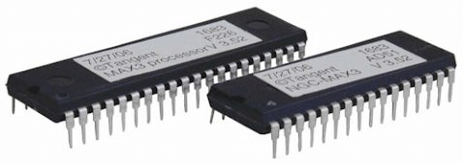
ROM

Slide 61
The BIOS (Basic Input/Output System) is the first program that runs when you turn on your computer.
The BIOS performs the POST(power on self test), which initializes and tests your computer's hardware.

Slide 62
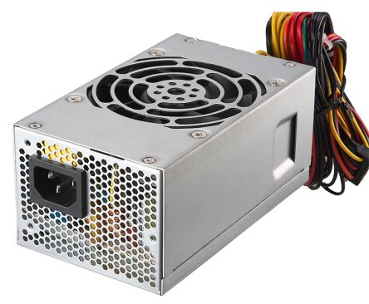
Power Supply
SMPS Stands for Switch Mode Power Supply ·
Supplies power supply to every single part of the computer system.

Slide 63
Motherboard
The motherboard connect all of the parts of a computer together.
It connects the CPU, memory, hard drives, optical drives, video card, sound card, and other ports and expansion cards directly or via cables.
It can be considered as the backbone of a computer.

Slide 64
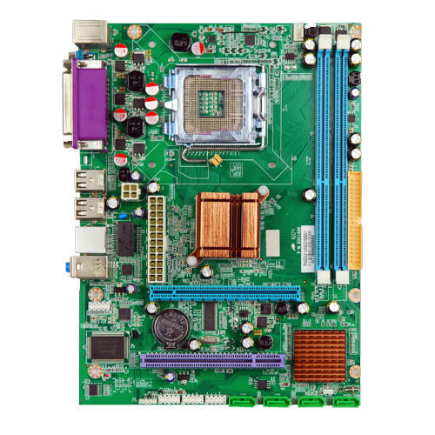
Motherboard

Slide 65
Software
Software is the set of programs (instructions) that tell a computer what to do”
There are two types of software :
System software
Application software

Slide 67
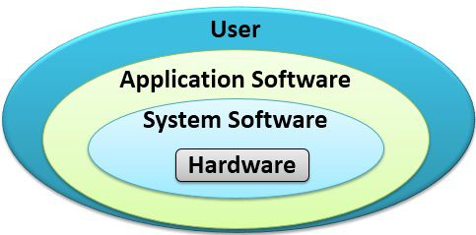

Slide 69
What is an Operating System?
An Operating system (OS) is a software which acts as an interface between the user and computer hardware.
Every computer must have at least one OS to run other programs.
An application like Chrome, MS Word, Games, etc needs some environment in which it will run and perform its task.
The OS helps you to communicate with the computer without knowing how to speak the computer's language.
It is not possible for the user to use any computer or mobile device without having an operating system.

Slide 73
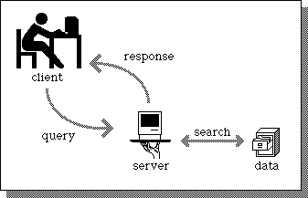
Client-Server Computing Environment
The client-server environment contains two machines (Client machine and Server machine).
Here Client is a normal computer like PC, and Server is a powerful computer which stores huge data and manages the huge amount of file and emails, etc.,
In this environment, client requests for data and server provides data to the client.

Slide 75
Computer Languages
Around the world language is a source of communication among human beings.
To communicate with computer user also needs to have a language, that should be understandable by the computers.
For the purpose different languages are developed for performing different types of work on the computer.

Slide 77
Machine language
Machine language is the low level programming language.
Machine language can only be represented by 0s and 1s.
In earlier when we have to create a picture or show data on the screen of the computer then it is very difficult to draw using only binary digits(0s and 1s).
For example: To write 120 in the computer system its representation is 1111000.
So it is very difficult to learn.
To overcome this problem the assembly language is invented.

Slide 78
Machine Language Advantages:
Translation free:Machine language is the only language that computers can directly execute without the need for conversion.
High speed:No conversion is needed,the applications developed using machine language are extremely fast.

Slide 79
Machine Language Disadvantages:
It is very difficult to remember the operational codes and address of the memory locations.
Debugging of the program is very difficult.
Editing / modification of the program are difficult.
The instructions written in this language are machine dependent. The program written for one machine (computer) cannot run on another directly.

Slide 80
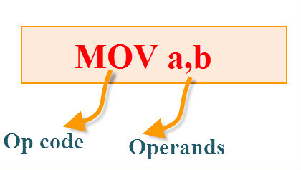
Assembly Language
The assembly language mnemonics are in the form of op-code, such as MOV, ADD, and so on, which are used to perform the operations.
Op-code: The op-code is a single instruction that can be executed by the CPU. Here the op-code is a MOV instruction.
Ex: opcodes – ADD, SUB, MULT, DIV etc.

Slide 81
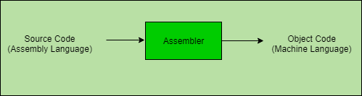

Slide 82
Assembly Language
Advantages:
User can remember the mnemonics rather than sequence of binary digits.
It is easy to understand and develop programs compared to machine language.
Modification and debugging of a program is easy.
Disadvantages:
It is machine dependent language.
The programs written in assembly language are not understandable to the computer so, they need a translator program (assembler) to convert the code written in assembly language into machine code.

Slide 83
High Level Languages
Advantages:
It is easy to understand and follow.
Easy to write, modify and debug programs.
Suitable for complex applications.
These languages are mostly machine independent.
Disadvantages:
The programs written using these languages are not understandable to the computer so, there is a need translator program to convert these languages into object code (interpreters and compilers).
Less efficient (slow) than the low level languages (fast)

Slide 84
High Level Languages
To speed up the programming process high level languages were developed.
Each instruction in these languages is like English statement.
These languages use alphabets, digits, punctuations and some special symbols.
Example:FORTRAN,C,C++,JAVA

Slide 85
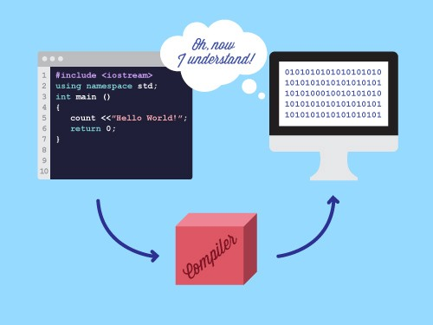

Slide 86
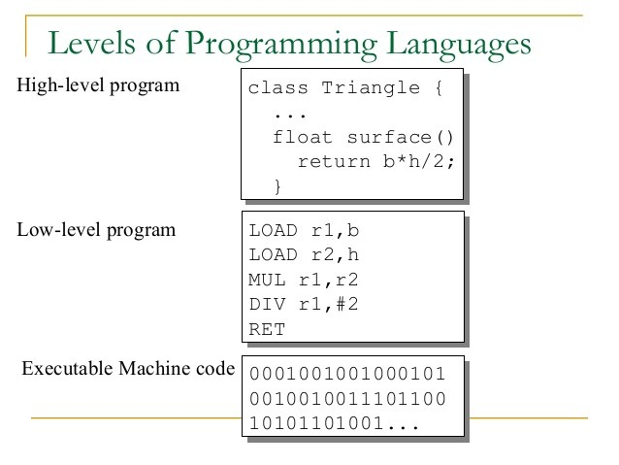

Slide 87
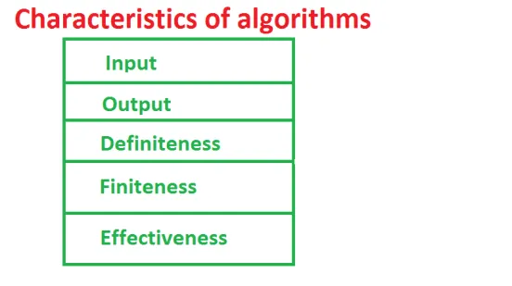
Algorithm
an algorithm is set of finite number of steps that should be followed in order to solve a particular problem.

Slide 88
Characteristics of Algorithm
Input: Algorithm can take zero, one or more than one input .
Output: Every algorithm produce some output as solution. Output is ultimate goal of an algorithm.
Definiteness: The steps in the algorithms should be clear and unambiguous. Every steps in algorithm should not have confusing meaning .
Finiteness: No of steps in the algorithms should be finite. Algorithm must have countable number of steps so that algorithm can terminate. Otherwise we cannot expect output from algorithm.
Effectiveness: Each and every step in algorithm should be simple , basic and meaningful. Unnecessary steps should be omitted. Every step should be effective means that each step should perform some action like input, process or output. Unwanted steps make algorithm long and complex.

Slide 90
Algorithm to find the average of five numbers.
Step 1: START.
Step 2: read the numbers n1, n2, n3, n4, n5.
Step 3: compute the sum of five numbers.(Sum =n1+n2+n3+n4+n5)
Step 4: divide the sum by 5. (avg= sum/5)
Step 5: print theresult.
Step 6: STOP.

Slide 92
ALGORITHM TO PRINT THE LARGER OF TWO NUMBERS

Slide 93
Algorithm to find the biggest among three numbers.
Step 1: START.
Step 2: read three values a, b, and c.
Step 3: if a>b and a>c then print a is big.
Step 4: else if b>a and b>c then print b isbig. Step 5: else print c is big.
Step 6:STOP.

Slide 94
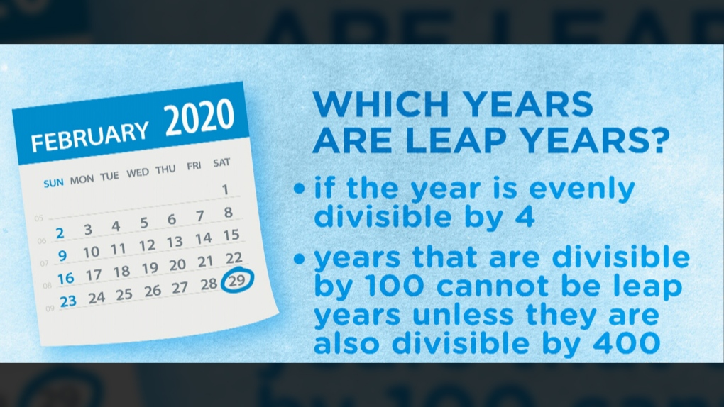
Algorithm to determine whether the given year is a leap year or not.
Step 1: START
Step 2:Accept an year value from the user
Step 3:If remainder of year value divided by 4(year%4) is 0 then goto step 4 else goto step 5
Step 4: Display “ ‘year’ is a leap year” and goto step 6
Step 5:Display “ ‘year is not a leap year”
Step 6:STOP.

Slide 95
Algorithm to find out whether a given number is even or odd.
Step 1: START
Step 2:Accept a number from the user (num)
Step 3:If remainder of num divided by 2 (num/2) is 0 then goto step 4 else goto step 5
Step 4: Display “ num is an even number” and goto step 6
Step 5:Display “ num is an odd number”
Step 6:STOP.

Slide 96
FLOWCHART
A Flowchart is a pictorial representation of an algorithm.
It shows the logic of the algorithm and the flow of control.
The flowchart uses symbols to represent specific actions and arrows to indicate the flow of control.

Slide 97
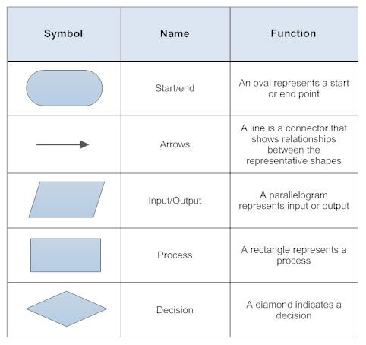

Slide 101
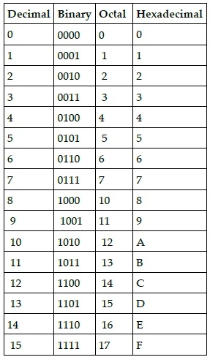

Slide 102
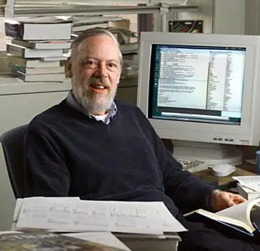
C programming language was developed in 1972 by Dennis Ritchie at bell laboratories of AT&T (American Telephone & Telegraph), located in the U.S.A.

Slide 103
Major parts operating systems like Windows, UNIX, Linux, and Android are written in C.
Even today when performance (speed of execution) is considered, C becomes primary choice of programmers.
You know very well how much popular is android.
Just think about a modern world without operating systems like Windows, Linux, Unix. Without Operating System computer is nothing more than a box.
We must be thankful to Dennis Ritchie, who has founded this amazing programming language.

Slide 104
Mobile devices like smartphones and tablets have become very popular today. Also common devices like the washing machine, microwaves are getting smarter by the day.
This smartness comes from a microprocessor. These programmes need to run fast as well as they need to work in a constrained measure of memory. these programs are written in C.
Think about the importance of washing machine, digital calculator, microwaves. Assume, the world without these embedded appliances because for embedded system C is the primary choice for a programmer.

Slide 105
Microsoft’s Windows kernel (The kernel is a computer program at the core of a computer's operating system with complete control over everything in the system.) is developed mostly in C, with some parts of assembly language.
Linux’s kernel is also written in C.
Every driver and program in mac is running on a C-powered kernel.
Ios, android, and windows phone kernel are also written in C.
World’s popular databases, including Oracle, MYSQL, are coded in C. (with C++)
3D movies are created with applications that are generally written in C.
Python also is written in C.

Slide 106
C Features
Robust
Middle level language
Fast
Portable
Structured programming
Easy to extend

Slide 113
Identifiers

Slide 114
int number1=20,number2=30,sum;
Here, number1 ,number2 and sum are identifiers.
--------------------------------------------
Example of invalid identifiers
2sum (starts with a numerical digit)
int (reserved word)
char (reserved word)
m+n (special character, i.e., '+')

Slide 121
variables
when we want to use some data value in our program, we can store it in a memory space and name the memory space so that it becomes easier to access it.
The naming of an address is known as variable. Variable is the name of memory location.
Unlike constant, variables are changeable, we can change value of a variable during execution of a program.
A programmer can choose a meaningful variable name.
Example : average,
height,
age,
total etc.

Slide 126
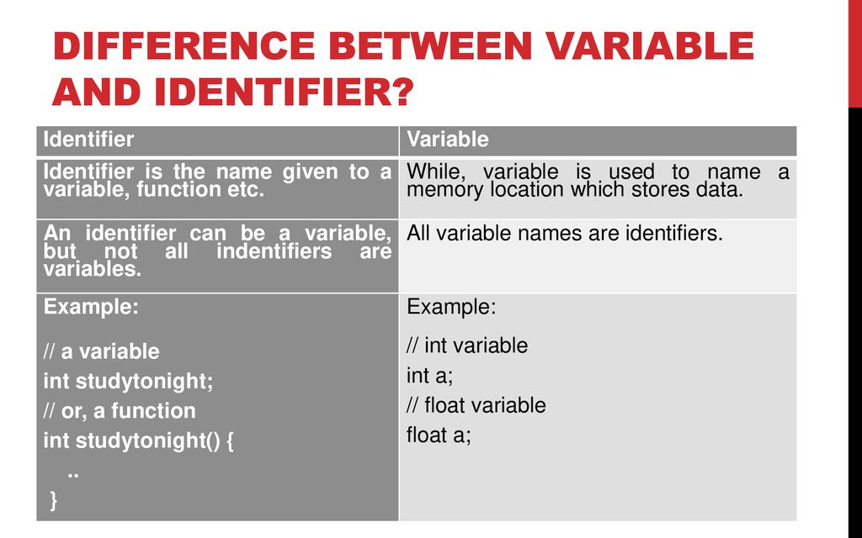

Slide 127
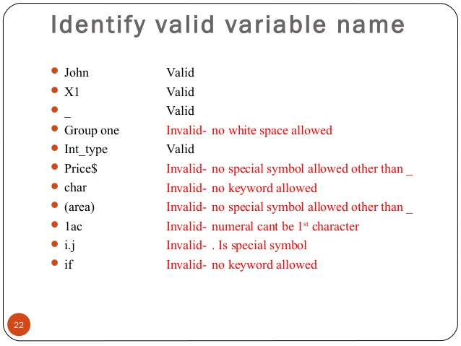

Slide 128
Data types
Data types specify what type of data we enter.
Data type determines the type of data a variable will hold. If a variable x is declared as int. it means x can hold only integer values.

Slide 129
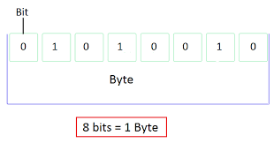

Slide 130
#include>stdio.h>
void main()
{
int a = 10;
char b = 'S';
float c = 2.88;
double d = 28.888;
printf("Integer datatype : %d\n",a);
printf("Character datatype : %c\n",b);
printf("Float datatype : %f\n",c);
printf("Double Float datatype : %lf\n",d);
}

Slide 131
Difference between float and double
double has 15 decimal digits of precision.
3.456789812345678
float has 7 decimal digits of precision.
3.6789058

Slide 132
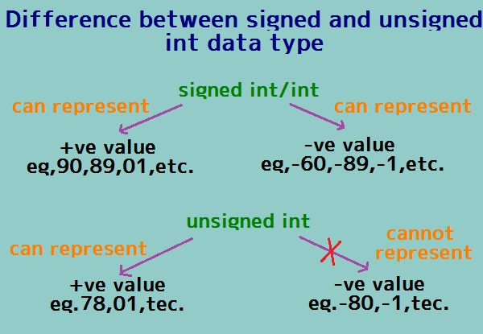
We can use signed and unsigned keywords with only 'int' and 'char' data types.

Slide 134
How is a character value stored?
Whenever a character value is given to a variable of type char, its ASCII value gets stored (and not the character value).
#include <stdio.h>
void main()
{
char ch='a';
printf("\nCharacter value of character = %c", ch);
printf("\nASCII value = %d\n", ch);
}
Output
Character value of character =a
ASCII value = 97
When we gave the value 'a' to the variable 'ch', the ASCII code (97) of 'a' gets stored in ch. So, %d displayed its integer value i.e., ASCII value and %c displayed its character value.

Slide 135
128
+
127
------
255 (unsigned takes only positive values.)
-------
The basic instruction length is either 2 or 4 bytes.

Slide 136
If you need to use a large number, you can use long
If you are sure, only a small integer ([−32,767, +32,767] range) will be used, you can use short.

Slide 140
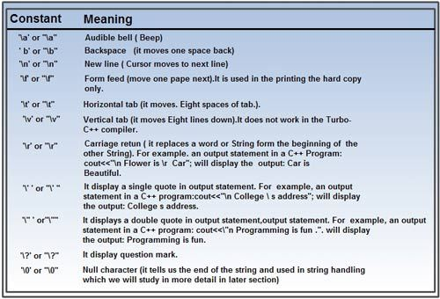
Escape Sequences

Slide 141
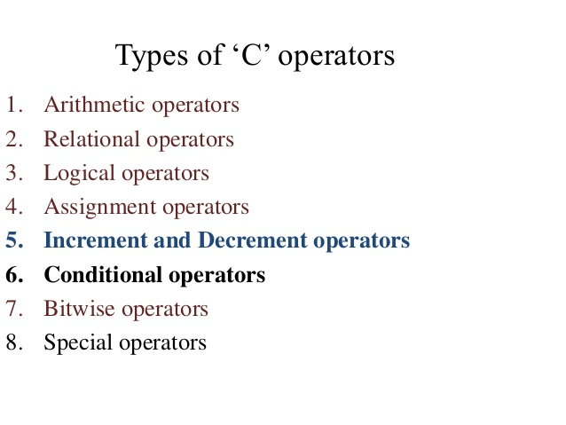
Operators
An operator is a symbol that operates on a value or a variable. For example: + is an operator to perform addition.

Slide 142
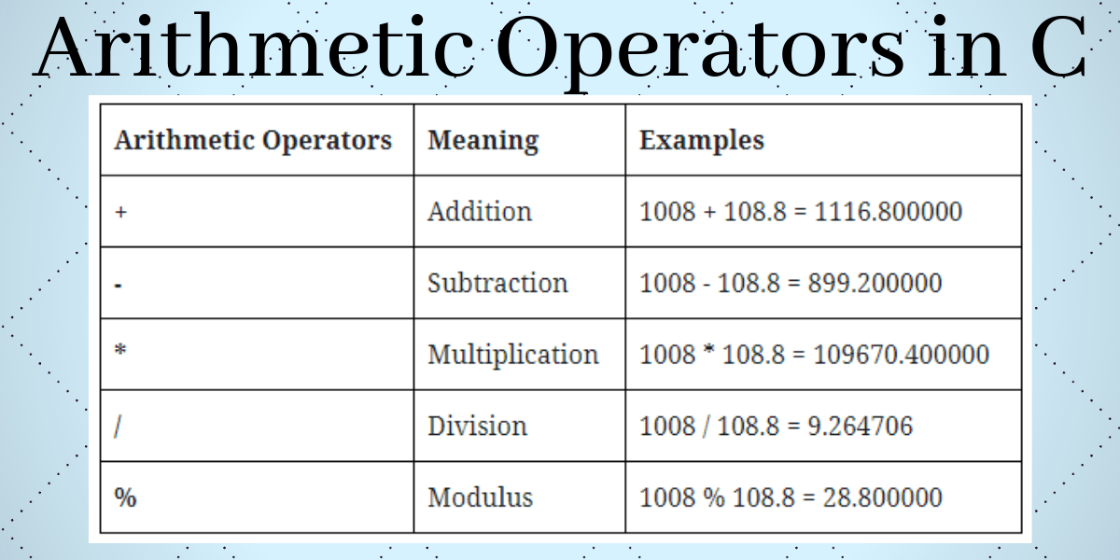

Slide 148
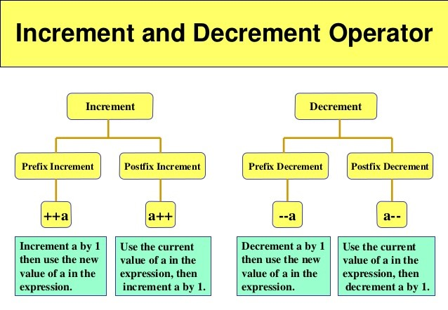

Slide 149
post increment & pre increment
a=5;
b=a++;
a=6
b=5
a=5;
b= ++a;
a=6
b=6

Slide 150
post decrement & pre decrement
a=5;
b=a--;
a=4
b=5
a=5;
b=--a;
a=4
b=4

Slide 152
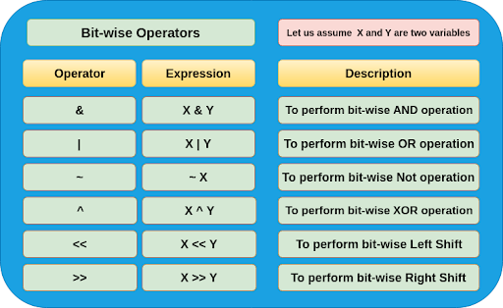

Slide 153
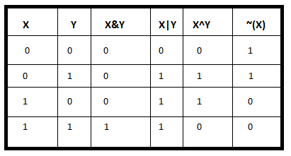

Slide 159
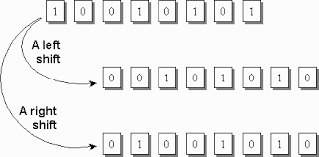

Slide 166
#include <stdio.h>
void main()
{
int a = 20; /* 20 = 010100 */
int b = 21; /* 21 = 010101 */
int c = 0;
c = a & b; /* 20 = 010100 */
printf("AND - Value of c is %d\n", c );
c = a | b; /* 21 = 010101 */
printf("OR - Value of c is %d\n", c );
c = a ^ b; /* 1 = 0001 */
printf("Exclusive-OR - Value of c is %d\n", c );
}
output:
AND - Value of c is 20
OR - Value of c is 21
Exclusive-OR - Value of c is 1

Slide 168
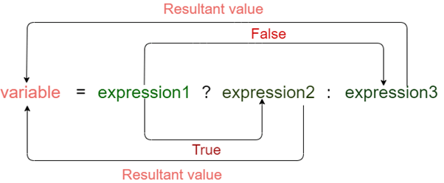
conditional operator

Slide 170
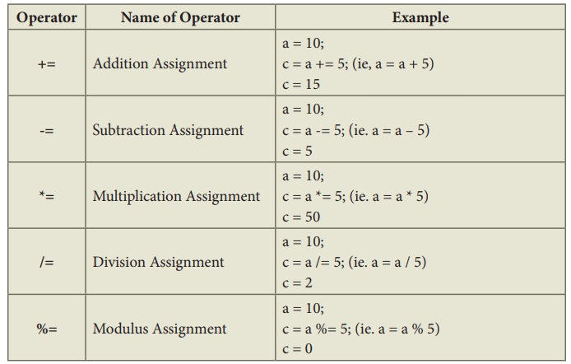
Assignment Operators

Slide 173
The sizeof(variable)operator computes the size of a variable.
#include<stdio.h>
void main()
{
int a;
float b;
double c;
char d;
printf("Size of int: %d bytes\n", sizeof(a));
printf("Size of float: %d bytes\n", sizeof(b));
printf("Size of double: %d bytes\n", sizeof(c));
printf("Size of char: %d byte\n", sizeof(d));
}
Output
Size of int: 4 bytes
Size of float: 4 bytes
Size of double: 8 bytes
Size of char: 1 byte

Slide 174
comma operator
comma operator used as a separator.
int a=3,b=4,c=5;
multiple definitions in a single line

Slide 175
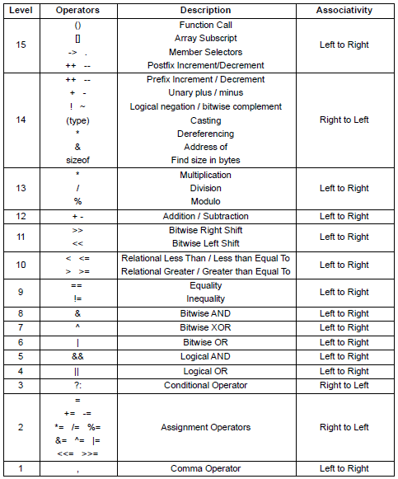

Slide 177
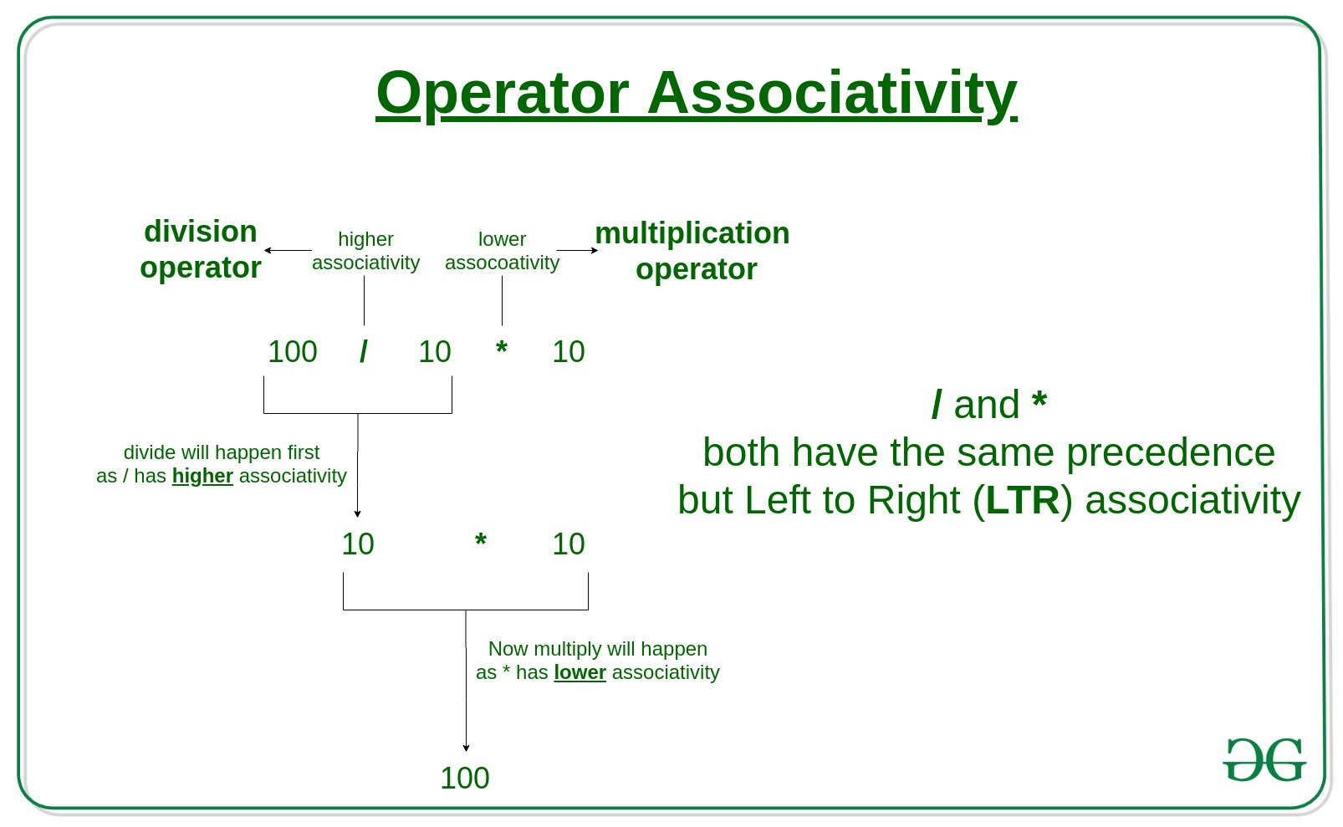

Slide 178


Slide 180
main()
{
int x;
x = 3*4%5;
printf ("x = %d",x);
}

Slide 181
output:
x = 2
Explanation
The first operation performed here is multiplication, which yields 12.
And then 12 % 5 is performed, which yields the remainder 2.
This 2 is assgined to the variable x and then printed out.

Slide 182
Type Casting
Converting one datatype into another is known as type casting or, type-conversion.
2 types
1) implicit type casting
2) explicit type casting
Explicit type casting
You can convert the values from one type to another explicitly using the cast operator as follows −
syntax: (type_name) expression

Slide 183
#include <stdio.h>
main()
{
int sum = 17, count = 5;
float mean;
mean = (float) sum / count;
printf("Value of mean : %f\n", mean );
}
output:
Value of mean : 3.400000
It should be noted here that the cast operator has precedence over division, so the value of sum is first converted to type double and finally it gets divided by count yielding a float value.

Slide 184


Slide 185
implicit type casting
#include<stdio.h>
int main()
{
int x = 10; // integer x
char y = 'a'; // character c
// y implicitly converted to int. ASCII
// value of 'a' is 97
x = x + y;
// x is implicitly converted to float
float z = x + 1.0;
printf("x = %d, z = %f", x, z);
}
x = 107, z = 108.000000

Slide 186
conditional statements
Conditional Statements in C programming are used to make decisions based on the conditions.
Conditional statements execute sequentially when there is no condition around the statements.
If you put some condition for a block of statements, the execution flow may change based on the result evaluated by the condition.
This process is called decision making in 'C.'

Slide 187
Conditional Statements
if
if else
nested if-else
else if ladder

Slide 188

if statement

Slide 189


if-else statement

Slide 191

Nested If-else Statements

Slide 193
Syntax:
if (condition 1)
{
// block 1
}
else if (codition 2)
{
// block 2
}
else if(codition 3)
{
// block 3
}
else
{
// default block
}
else if ladder
When we have multiple options available or we need to take multiple decisions based on available condition, we can use another form of if statement called else…if ladder.
In else…if ladder each else is associated with another if statement.
Evaluation of condition starts from top to down.
If condition becomes true then the associated block with if statement is executed and rest of conditions are skipped.
If the condition becomes false then it will check for next condition in a sequential manner.
It repeats until all conditions are cheeked or a true condition is found.
If all condition available in else…if ladder evaluated to false then default else block will be executed.

Slide 194


Slide 195

else-if ladder

Slide 196


Slide 197
switch statement
Consider a situation in which we have many options out of which we need to select only one option that is to be executed.
Such kind of problems can be solved using nested if statement.
But as the number of options increases, the complexity of the program also gets increased.
This type of problem can be solved very easily using a switch statement. Using the switch statement, one can select only one option from more number of options very easily.
In the switch statement, we provide a value that is to be compared with a value associated with each option.
Whenever the given value matches the value associated with an option, the execution starts from that option.
In the switch statement, every option is defined as a case.

Slide 198
switch statement

Slide 199
syntax
The expression can be integer expression or a character expression.
Value-1, 2, n are case labels which are used to identify each case individually. Remember that case labels should not be same as it may create a problem while executing a program. Suppose we have two cases with the same label as '1'. Then while executing the program, the case that appears first will be executed even though you want the program to execute a second case. This creates problems in the program and does not provide the desired output.
Case labels always end with a colon ( : ). Each of these cases is associated with a block.
A block is nothing but multiple statements which are grouped for a particular case.
Whenever the switch is executed, the value of test-expression is compared with all the cases which we have defined inside the switch. Suppose the test expression contains value 4. This value is compared with all the cases until case whose label four is found in the program. As soon as a case is found the block of statements associated with that particular case is executed and control goes out of the switch.
The break keyword in each case indicates the end of a particular case. If we do not put the break in each case then even though the specific case is executed, the switch in C will continue to execute all the cases until the end is reached. This should not happen; hence we always have to put break keyword in each case. Break will terminate the case once it is executed and the control will fall out of the switch.
The default case is an optional one. Whenever the value of test-expression is not matched with any of the cases inside the switch, then the default will be executed. Otherwise, it is not necessary to write default in the switch.
Once the switch is executed the control will go to the statement-x, and the execution of a program will continue.

Slide 200


Slide 201
#include<stdio.h>
#include<conio.h>
void main(){
int n ;
clrscr() ;
printf("Enter any digit: ") ;
scanf("%d", &n) ;
switch( n )
{
case 0: printf("ZERO") ;
break ;
case 1: printf("ONE") ;
break ;
case 2: printf("TWO") ;
break ;
case 3: printf("THREE") ;
break ;
case 4: printf("FOUR") ;
break ;
case 5: printf("FIVE") ;
break ;
case 6: printf("SIX") ;
break ;
case 7: printf("SEVEN") ;
break ;
case 8: printf("EIGHT") ;
break ;
case 9: printf("NINE") ;
break ;
default: printf("Not a Digit") ;
}
}

Slide 202
LOOPING STATEMENTS
In C, and all other modern programming languages, iteration statements (also called loops) allow a set of instructions to be repeatedly executed until a certain condition is reached.
This condition may be predetermined (as in the for loop) or open-ended (as in the while and do-while loops).

Slide 203


Slide 204
While loop
Syntax while loop
The while loop is C’s most fundamental loop statement. while loop executes statements repeatedly while the condition is true.

Slide 205
while(expression)
{
..............
program statement
..............
}
Expresion or loop continuation condition
The expression specified inside the parentheses is evaluated. If the result of the expression evaluation is true. The program statement that immediately follows is executed. After execution of this statement (or statements,if enclosed in braces), expression is again evaluated. If the result of the evaluation is true, the program statement is again executed. This process continues until expression finally evaluates false, at which point the loop is terminated. Execution of the program then continues with the statement that follows program statement.
The condition may be any expression, and true is any nonzero value.
program statement or Loop body:
The program statement is either an empty statement, a single statement, or a block of statements.
Braces { }:
The curly braces are unnecessary if only a single statement is being repeated.

Slide 207
Explanation
The program initially sets the value of count to 1; execution of the while loop then begins. Because the value of count is less than or equal to 5, the statement that immediately follows is executed. The braces define both the print statement and the statement that increments count as the body of the while loop. From the output of the program, you can see that this loop is executed five times or until the value of count reaches 5 .

Slide 210

for loop

Slide 212


Slide 213

goto statement
C-language provides goto statement to transfer control unconditionally to other part of the program.
Although use of goto statement is not advisable but sometime it is desirable to use go to statement.
It has the following form:
goto Statement

Slide 215
Write a program to find the sum and average of three numbers.
INPUT:
Enter any three integers:2 4 5
OUTPUT:
Sum and average of three integers: 11 3

Slide 216
Write a program to calculate simple interest(SI) for a given principal (P), time (T), and rate of interest (R) using formula SI= ((amount*rate*time)/100) Interest.
#include<stdio.h>
void main()
{
int p,r,t,si;
printf("Input principle:");
scanf("%d",&p);
printf("Rate of interest:");
scanf("%d",&r);
printf("Enter time(in years):");
scanf("%d",&t);
si=(p*r*t)/100;
printf("Simple interest =
}
Input principle:10000
Rate of interest:12
Enter time(in years):2
EXPECTED OUTPUT:
Simple interest = 2400

Slide 217
Write a program to swap two variables values with using third variable

Slide 218


Slide 219
Write a program to swap two variables values without using third variable

Slide 220


Slide 221
Write a C program to find the sum of individual digits of a given positive integer.

Slide 222


Slide 223


Slide 224


Slide 225
Write a C program, which takes two integer operands and one operator from the user, performs the operation and then prints the result. (Consider the operators +,-,*, /, % and use Switch Statement)

Slide 226
AIM: To Check whether given number is Armstrong Number or Not
Description:
An Armstrong number of three digits is an integer such that the sum of the cubes of its digits is
equal to the number itself. For example, 371 is an Armstrong number since 3**3 + 7**3 + 1**3 = 371

Slide 228


Slide 230
#include<stdio.h>
void main()
{
int n,i=1,sum=0;
printf("Enter a number: ");
scanf("%d",&n);
while(i<n)
{
if(n%i==0)
sum=sum+i;
i++;
}
if(sum==n)
printf("%d is a perfect number",i);
else
printf("%d is not a perfect number",i);
}

Slide 231
INPUT:
Enter a number:6
OUTPUT:
6 is a perfect number

Slide 232


Slide 238


Slide 239
Reverse a number program
#include <stdio.h>
int main()
{
int n, rev = 0, remainder;
printf("Enter an integer: ");
scanf("%d", &n);
while (n != 0)
{
remainder = n % 10;
rev = rev * 10 + remainder;
n /= 10;
}
printf("Reversed number = %d", rev);
return 0;
}
Enter an integer: 2345
Reversed number = 5432

